Slide 1
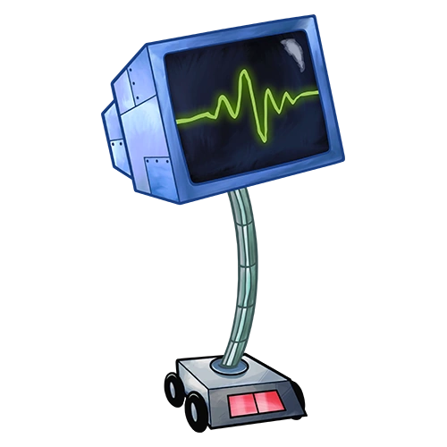

KARE-N
Because we kare

Slide 2

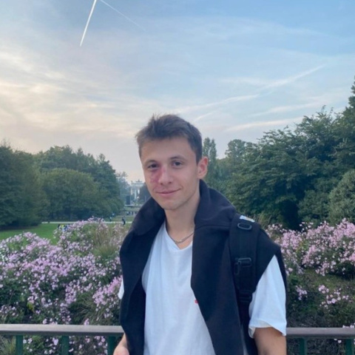


TEAM
P&P s.r.l.
Davide
Filippo

Slide 3

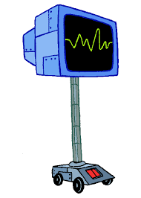
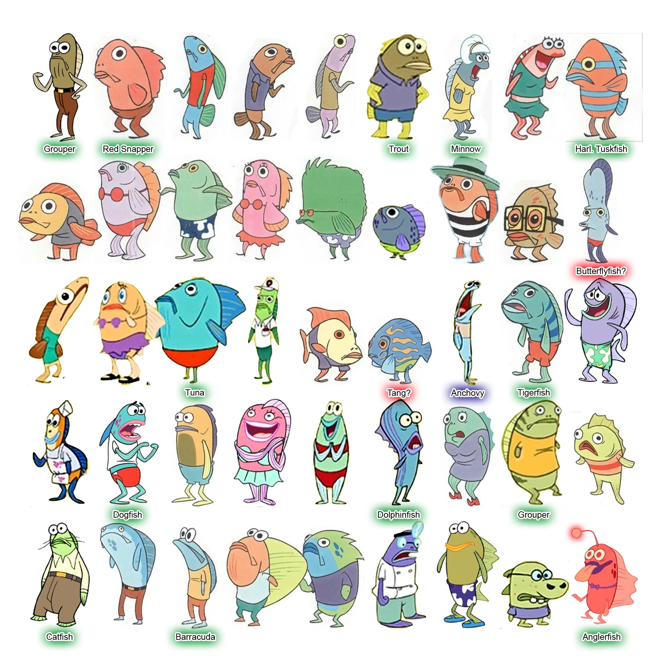
Would you talk to somebody who can’t understand you?
Ok, so two chum-patty?
Krabby patty
please
A chum-stick
for me

Slide 4

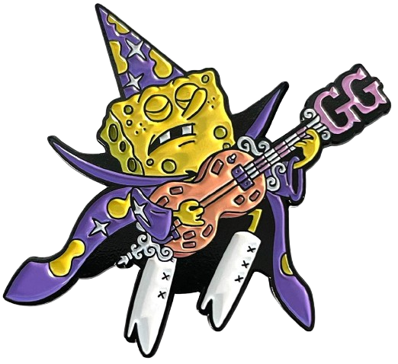
NOISE

Slide 5
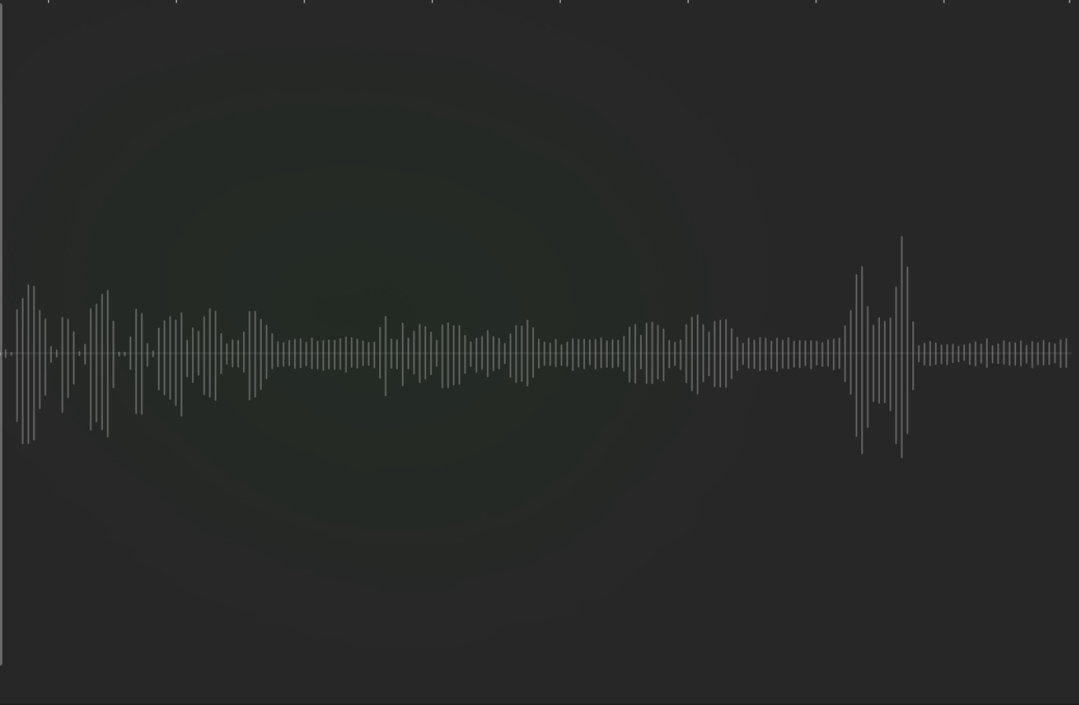

Noisy audio input

Slide 6
Noisy audio input
NOISY RANGE!!!!

Slide 7
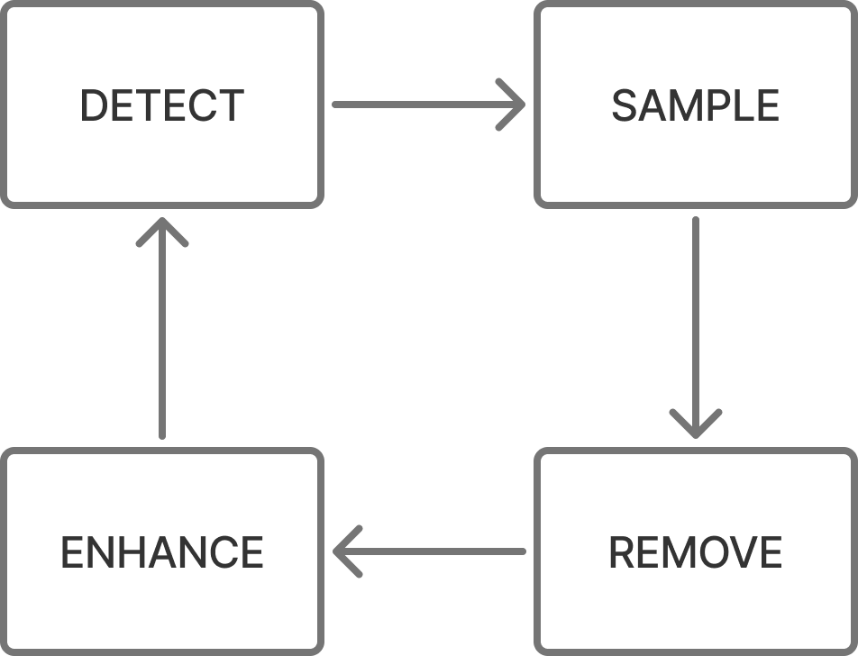
Our solution:

Slide 8
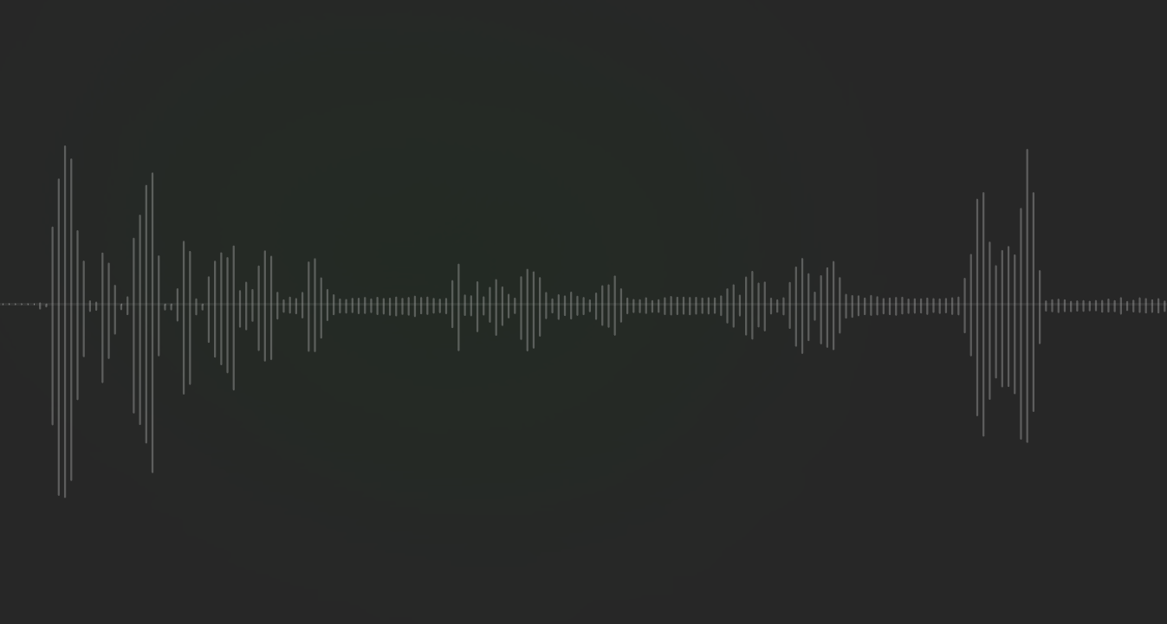
RESULT: Lower noise and Higher voices

Slide 9
Comparison

Slide 10
What if we hear something not relevant to the conversation?

Slide 11
Kare-ing about the right things
Before responding, Kare-n evaluates whether the question is relevant and then decides whether to answer.

Slide 12
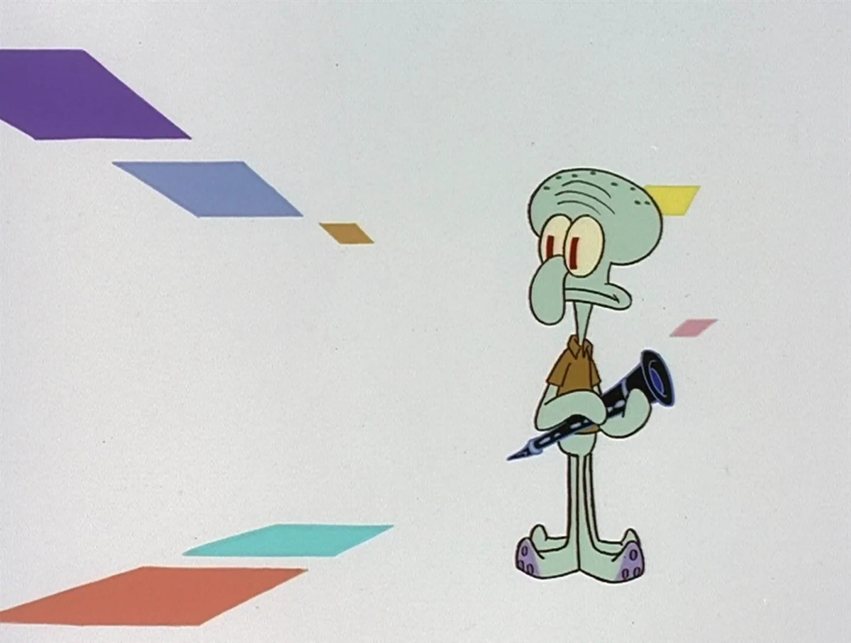
USER
PROFILING

Slide 13
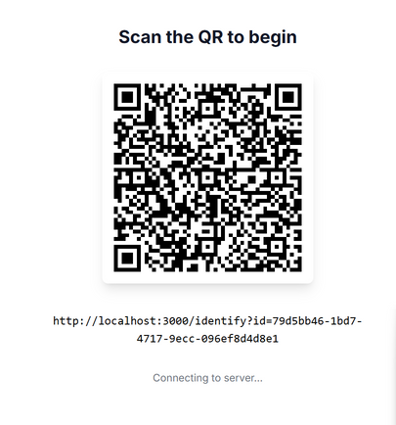
SCAN THE QR
&
GET THE MENU

Slide 14

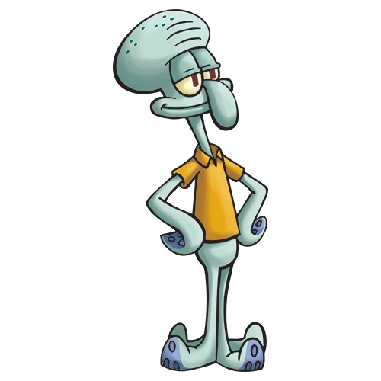
A crabby patty with:
double salad
half patty
onions
double half patty
No fries today
SquidWard?

Slide 15
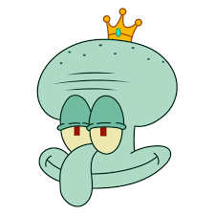


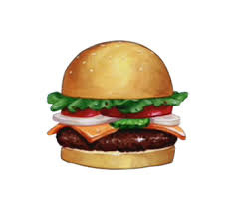
HOW ?
General Profiling: Constantly monitoring the conversation to determine if it relates to you and your habits.
DB
KARE-N
Order Logs: Ensuring the right dish is always suggested.

Slide 16
Voice Labelling

Slide 17


Our Solution:
Context Comprehension
likes crabby patty
hate fries
no order with salad
likes chump-sticks
enjoys fries
no order with salad

Slide 18
If multiple people are talking to Kare-n at the same time, we can try to predict who is speaking by analyzing what they are saying
... I’d like a patty
without salad ...
?

Slide 19

Advantages:
Fast
Gets better over time
The “confidence bottleneck” is the noise remover

Slide 20
PRIVACY
Since Karen only requires a one-time onboarding phase from the user, there are no privacy concerns.

Slide 21
THANKS FOR
THE ATTENTION
P&P s.r.l.

